Slide 1
Python Programming in Your Classroom
Presented by
Professor Reed, MBA
Notes:
Click to add notes

Slide 2
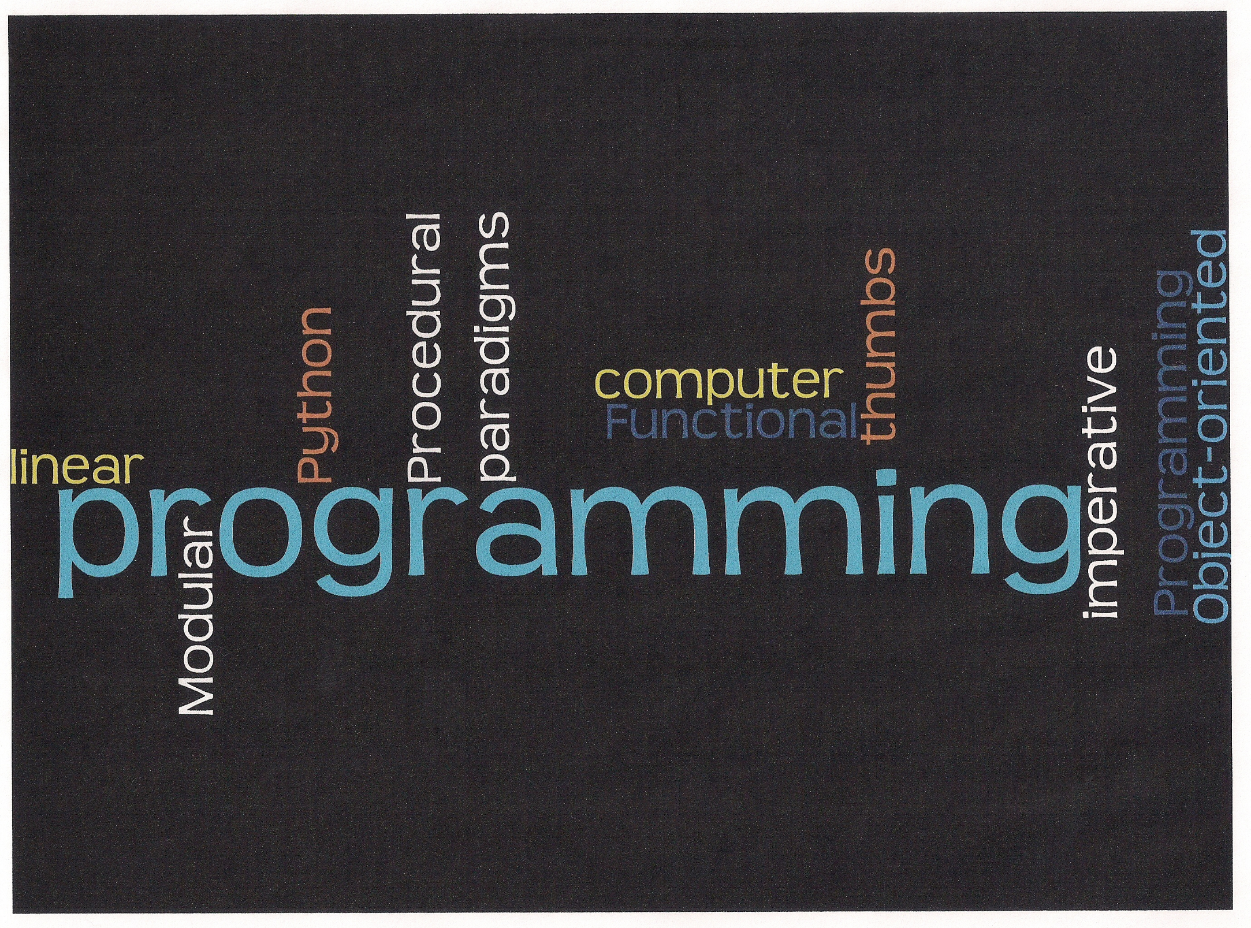

Slide 3
Housekeeping Items
Exits, Necessary Rooms, Refreshments, Etc. (from E170 out the door left & last lft)
Ground Rules (hold Q&A) – use Red/Grn
Cell Phones, Laptops, Tablets OK
Parking Lots
BYOD or BYOT Tutorial Style
Texts and support materials
Breaks on your own
Fill out BOTH my evaluation and the Conference evaluation

Slide 4
Welcome OETC 2014
Your Instructor, Professor Reed (“Jim”)
Topic: Using Python in Your Classroom
1969?
FORTRAN Programming on what???
I lied, its more like 30-35 yrs experience!!!
Due to the short session (≈1hr&45mins) Q&A generally will be held at the end of the remaining minutes of the entire presentation.
Notes:
I lied!

Slide 5
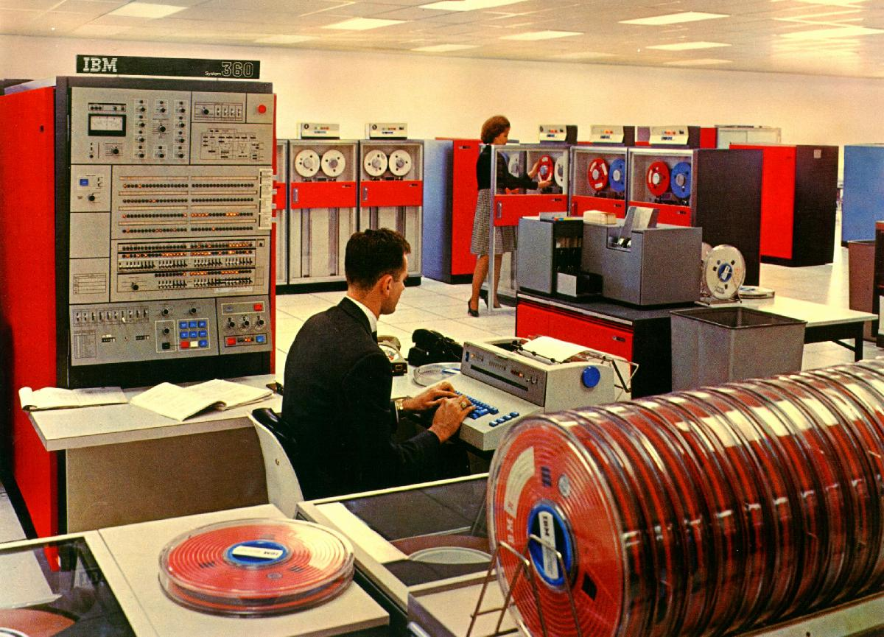
Dig a Little Deeper
IBM Mainframe System/360

Slide 6
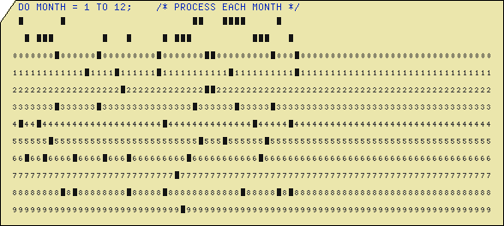
Dig Even a Little Deeper
IBM Hollerith Punch Card
Notes:
I lied!

Slide 7
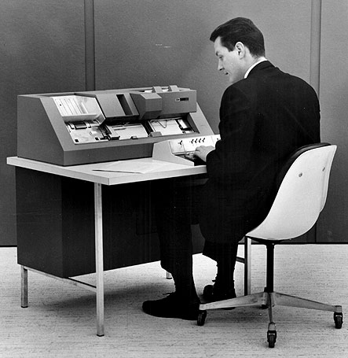
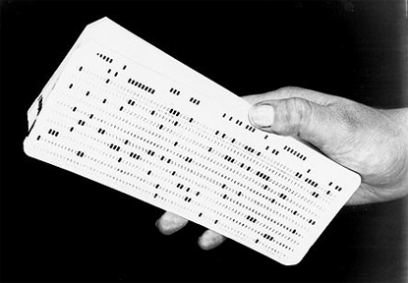
Dig Even a Little More Deeper
Notes:
Me typing up punch cards, well not exactly.

Slide 8
Take the pledge (raise your right hand NOW!)
Pledge #1 – I promise to review and practice these materials within the next 10 days – no excuses!
Pledge#2 – I promise to take some of these techniques to my classroom before the end of Spring Term 2014!
Notes:
Ok, now you need to promise me 2 things as shown.

Slide 9
Introduction
Python Programming Language is an easier introduction into computer programming.
Python provides a great beginning language while allowing students to explore more advanced computer science topics as skills grow with practice.
Professor Reed, has over 30 years of Computer Programming experience in business, government and academics.
Notes:
How presentation will benefit audience: Adult learners are more interested in a subject if they know how or why it is important to them.
Presenter’s level of expertise in the subject: Briefly state your credentials in this area, or explain why participants should listen to you.

Slide 10
Red & Green Bookmarks.
Since Teachers don’t like raising their hands—use the bookmarks as follows:
(Waive Green)
“Keep going your doing
Great!
(Waive Red)
Stop
And
Go back!
(Waive Red/Green)
Total
Confusion!
Notes:
My gift to you are two brand new bookmarks (red & green).

Slide 11
Professor Reed sez:
“Computer Language Programming is
NEVER easy!”
It’s
Hard
WORK!!!
Notes:
It’s Hard WORK!!!

Slide 12
President John F. Kennedy, address at Rice University, September 12, 1962
“We choose to go to the moon. We choose to go to the moon in this decade and do the other things, not because they are easy, but because they are hard, because that goal will serve to organize and measure the best of our energies and skills, because that challenge is one that we are willing to accept, one we are unwilling to postpone, and one which we intend to win . . . ”
President John F. Kennedy, address at Rice University, September 12, 1962
Neil Armstrong and the Crew of Apollo 11 landed on the Moon July 20th, 1969.

Slide 13
Training Outline (3 Modules)
Module 1: Introduce basics of a simple Python Computer Program.
How to install, setup, run and test your very first Python Computer Program.
Module 2: Going further with Python Programming.
Exploring the built-in graphical features of Python in support of math and science studies.
Module 3: Hazards and Threats.
Discussion and a demonstration of a potentially harmful use of a Python Computer Program.
Notes:
Module descriptions should be brief.
Module 1 – Setting up and running your first Python Computer Program.
Module 2 – Using Python graphic libraries in the support of Math and Science teaching and learning.
Module 3 – WEB Page Scraping and a brief word about possible or potential abuses by students.

Slide 14
Module 1: Objectives (Getting Python)
Locating Python Language on the WEB.
Python’s FREE!
Successfully installing Python on your computer platform.
Windows, Linux, Mac and others.
Writing your first complete Python Program.
Installing Python, testing and running a simple Python Computer Program in the classroom.
Using the Python Interpreter (IDLE).
Running and testing Python computer programs.
Notes:
Example objectives
At the end of this Module, you will be able to:
Save files to the team Web server.
Move files to different locations on the team Web server.
Share files on the team Web server.

Slide 15

Module 1: Getting Python
www.python.org/download/releases/3.3.3/
Minor controversy
Use Python 3.3 or better versus Python 2.7
Python 2.7 is essentially obsolete in most cases.
(PIL graphics library 2.7?)
(now use PILLOW for 3.3)!!!
Notes:
In general, we consider that we are using Python 3.3 on Windows 8.1, Python 3.4 is coming SOON!

Slide 16
Module 1: Wrapping up Getting Started with Python
Summary of Getting Started with Python
Please hold your Q&A until
the presentation end.
Coming up next,
Python Graphical features in support of
math and science.
Notes:
Did you have success?
Did you run your first Python Computer Program?
Will you keep your promise and take it back to your Classroom?

Slide 17
Program Examples – Module 1
But, first some
Program examples in support of Module 1!

Slide 18
Professor Reed sez:
“Computer Language Programming
is
The Business of Dealing
with Failure!!!”
Notes:
Remember Computer Programming is learning to deal with FAILURE!!!
Also, it confronts YOU directly as the programmer—no one else!
Get your students thumbs off the cell phones and tablets.

Slide 19

You have FEARS!!!
Notes:
You have FEARS!!!

Slide 20
Why Program Computers?
Can Help Your Students develop
Problem Solving
and
Researching Skills!

Slide 21
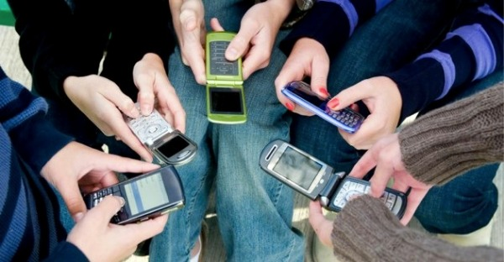

The “thumbers”!

Slide 22
Professor Reed sez:
“Computer Language Programming
is understanding that
ALL Computer Programs
only work part of the time???”
“Computer Programs only work for
some of the time for very specific
circumstances…”

Slide 23
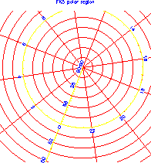
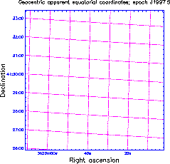
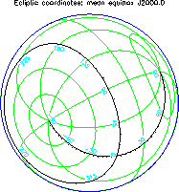
Module 2: Objectives (graphics)
Going further with Python Computer Programming Language.
Using Python Programming Language for multiple disciplines in the Classroom.
Exploring Python’s graphical features in support of math and science studies.

Slide 24
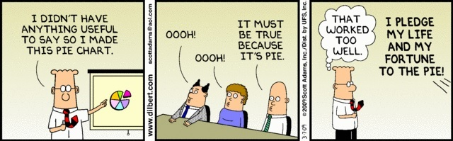
Something Important To Say!

Slide 25
Module 2: Why Use Python?
Extremely rich graphical environment.
Simple enough for use by even the most beginner of programming student to have success incorporating computer graphics into their math and science projects.
Graph comparing popular computer program languages.

Slide 26
Module 2: Wrapping up using the graphical features of Python.
Summary of using Python graphical features for math and science in the Classroom.
Again, please hold your questions until the end of my entire presentation.
Coming up next.
Demonstration of the real power of Python Computer Programming Language.

Slide 27
Program Examples – Module 2
Python Graphics
But, first some
Program examples in support of Module 2!

Slide 28


Curiosity's Seven Minutes of Terror
http://www.jpl.nasa.gov/video/index.php?id=1090
It's running 2.5 million lines of C on a RAD750 processor manufactured by BAE. The JPL has a bit more information but I do suspect many of the details are not publicized. It does appear that the testing scripts were written in Python.

Slide 29
The Truth About the AGC Computer
The so-called Apollo Guidance Computer (AGC) used a real time operating system, which enabled astronauts to enter simple commands by typing in pairs of nouns and verbs, to control the spacecraft. It was more basic than the electronics in modern toasters that have computer controlled stop/start/defrost buttons. It had approximately 64Kbyte of memory and operated at 0.043MHz.
The AGC was designed to be fault-tolerant and was able to run several sub programs in priority order.
Each of these sub programs was given a time slot to use the computer's sparse resources. During the mission the AGC became overloaded and issued a "1202" alarm code.
Neil Armstrong asked Mission Control for clarification on the 1202 error. Jack Garman, a computer engineer at NASA, who worked on the Apollo Guidance Program Section, told mission control that the error could be ignored in this instance, which meant the mission could continue. Apollo 11 landed a few seconds later.

Slide 30
Mars Polar Lander Lost!
(CNN) -- NASA lost a $125 million Mars orbiter because a Lockheed Martin engineering team used English units of measurement while the agency's team used the more conventional metric system for a key spacecraft operation, according to a review finding released Thursday.
The units mismatch prevented navigation information from transferring between the Mars Climate Orbiter spacecraft team at Lockheed Martin in Denver and the flight team at NASA's Jet Propulsion Laboratory in Pasadena, California.
Space craft declared lost on Dec. 3rd, 1999
Notes:
The difference between miles per hours and kilometers per hour.

Slide 31
Module 3: Objectives (WEB)
Discussion of Python Programming for better or worse.
For better.
Beginners can have outstanding results with little training in computer programming.
For worse.
Security concerns. Simple published routines for malicious hacking. Powerful routines and ethical treatment in the Classroom.
(OWASP Security Project Member)
Notes:
OWASP (Open Web Application Security Project) – not for profit.

Slide 32
Module 3: Content
WEB Page Scraping
Allows independent
research and student investigation on the WEB.
Provided fast and direct access to unpublished web features.
http://money.cnn.com/data/dow30
http://money.cnn.com/data/dow30
Notes:
Touch above money url to access the dow30 web site.

Slide 33
Program Examples – Module 3
WEB Page Scraping
But, first some
Program examples in support of Module 3!
Notes:
Web page scrapping can have many uses in researching on the internet or WEB!
Also, will challenge your students problem solving skills.
So much is handed to them on pre-formatted web pages!!!

Slide 34
Summarization of Python
In Summary:
Setting up and successfully running your first Python Computer Program.
Using the powerful supplied Python Libraries for graphical views of the various sciences and mathematics.
Potential Concerns, Ethical Considerations and Threats and Misuses of Python Computer Program Language.
Further Reading and Resources:
List resources on the next slide.
Read the provided Handouts with additional resource material indicated there as well.

Slide 35
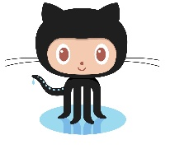
Other Resources!
GITHUB
https://github.com/profjrr

Slide 36
Wrapping up everything!
We have now summarized our important points.
And, now it’s time for your Questions???
Anything we discussed during this presentation.
(Installation and Setup; Graphics; Misuses)
Thanks for your kind attention.
Hope you find yourself using these techniques in the near future.
Please let us know how we are doing.

Slide 37
Assessment and Evaluation
Challenge yourself: install Python; design and run your first Python Program; and finally investigate the powerful Python libraries for your area of study and instruction.
Let us know how we are doing?
Complete my personal evaluation.
Complete our Host’s evaluation.

Slide 39
End of Presentation on Python
Thank you, Professor Reed!!!
###

